Slide 1
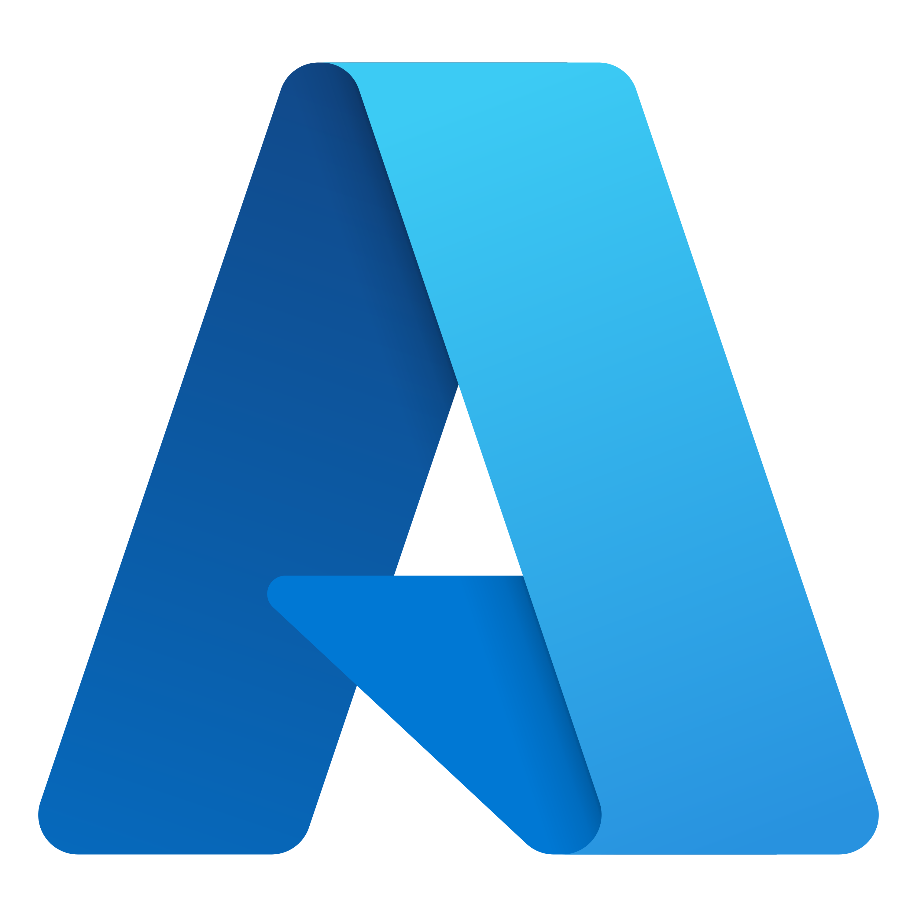
Building and operating cloud-native applications with Radius
Will Velida | Lead Software Engineer @ Mantel Group
@willvelida

Slide 3
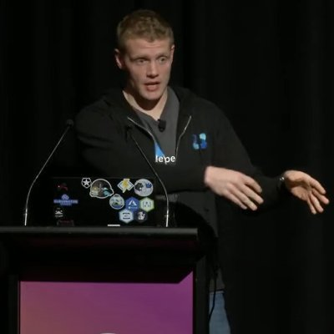
whoami?
Lead Software Engineer at Azenix by Mantel Group.
Former MSFTer and Microsoft MVP based in Auckland – Moved to Melbourne last year
.NET and Azure developer with experience in banking, agriculture, and health industries.
Former average rugby player.

Slide 4
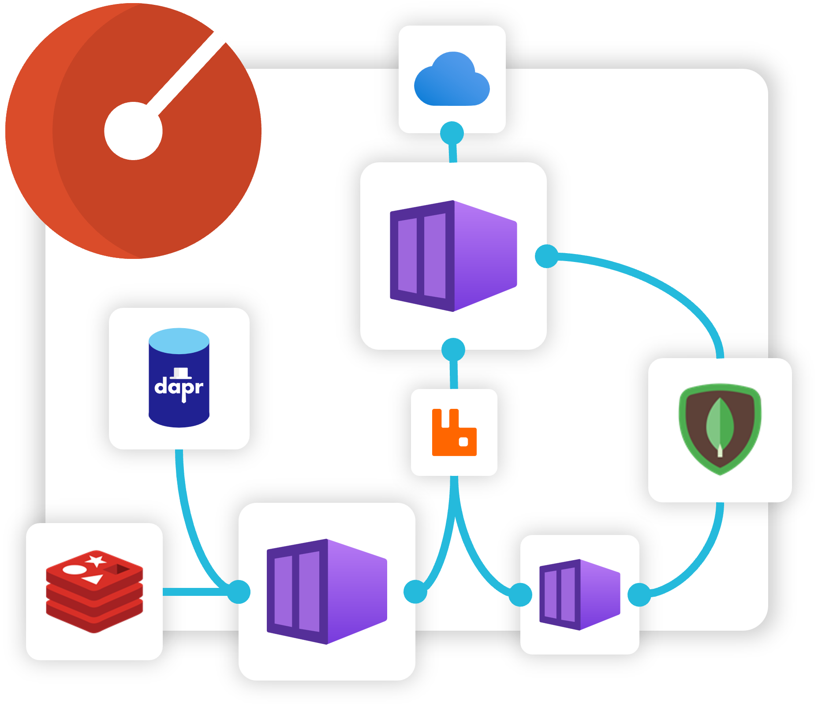
Agenda
What is Radius?
Radius Applications
Recipes
Environments
Demo

Slide 5
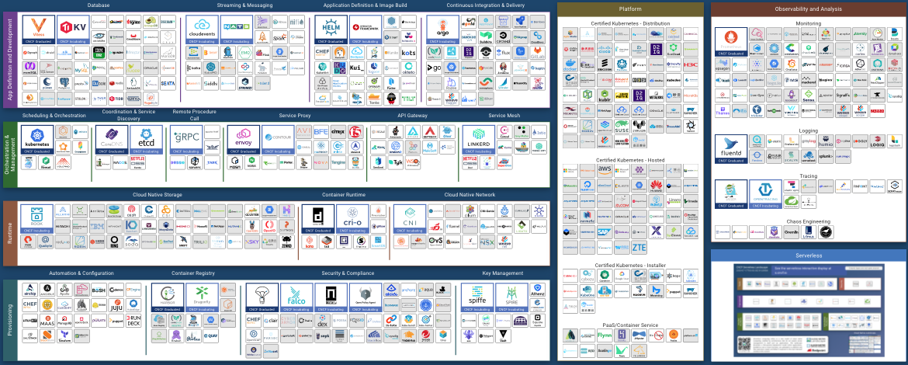
Applications are more than just Kubernetes!!!
Notes:
Anyone seen this diagram before?
There’s more to apps than Kubernetes! There’s so much more we need to think about (messaging, proxies, container registries, API gateways).

Slide 6
Common Problems
Applications are more than Kubernetes!
Developers, platform engineers, and IT Ops need to collaborate.
Applications lack an industry wide-definition.
Notes:
- Standardizing on Kubernetes has been successful for most enterprises, but this does come with more complexity than it’s worth. We also don’t just run our apps on Kubernetes. Maintaining and operating all our resources in our application is a full time job.
- We don’t develop in isolation anymore (and we really shouldn’t!!) To develop the type of complex apps that enterprises usually build, we need developers, platform engineers, and IT ops to collaborate. The tools that we use need to aid collaboration, not impede it.
- Platform engineers that support applications usually lack context about the architecture, while app developers lack context about the underlying cloud infrastructure. Together, we need a common understanding and visualization of what an application is.

Slide 7

Enter Radius
“Radius is an open-source, cloud-native application platform that enables developers and operators to develop and collaborate on cloud native apps across public and private clouds”
Notes:
“Radius is an open-source, cloud-native application platform that enables developers and operators to develop and collaborate on cloud native apps across public and private clouds”

Slide 8
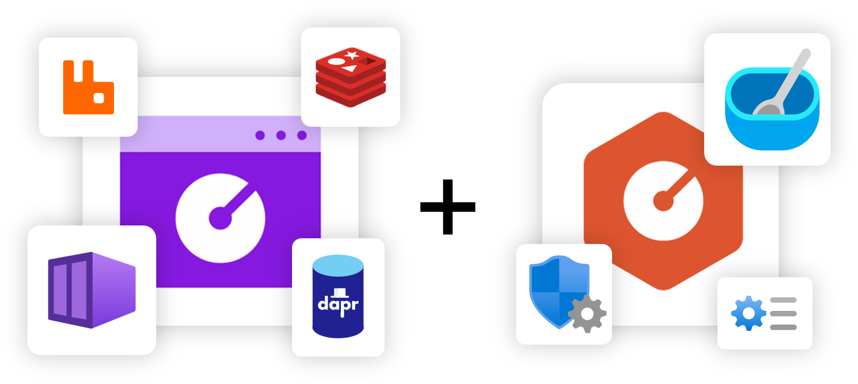
Developer + Operator Collaboration
Developers define applications and dependencies
Operators define environments .
Radius brings them together, deploying apps and infra that meet both requirements.

Slide 9
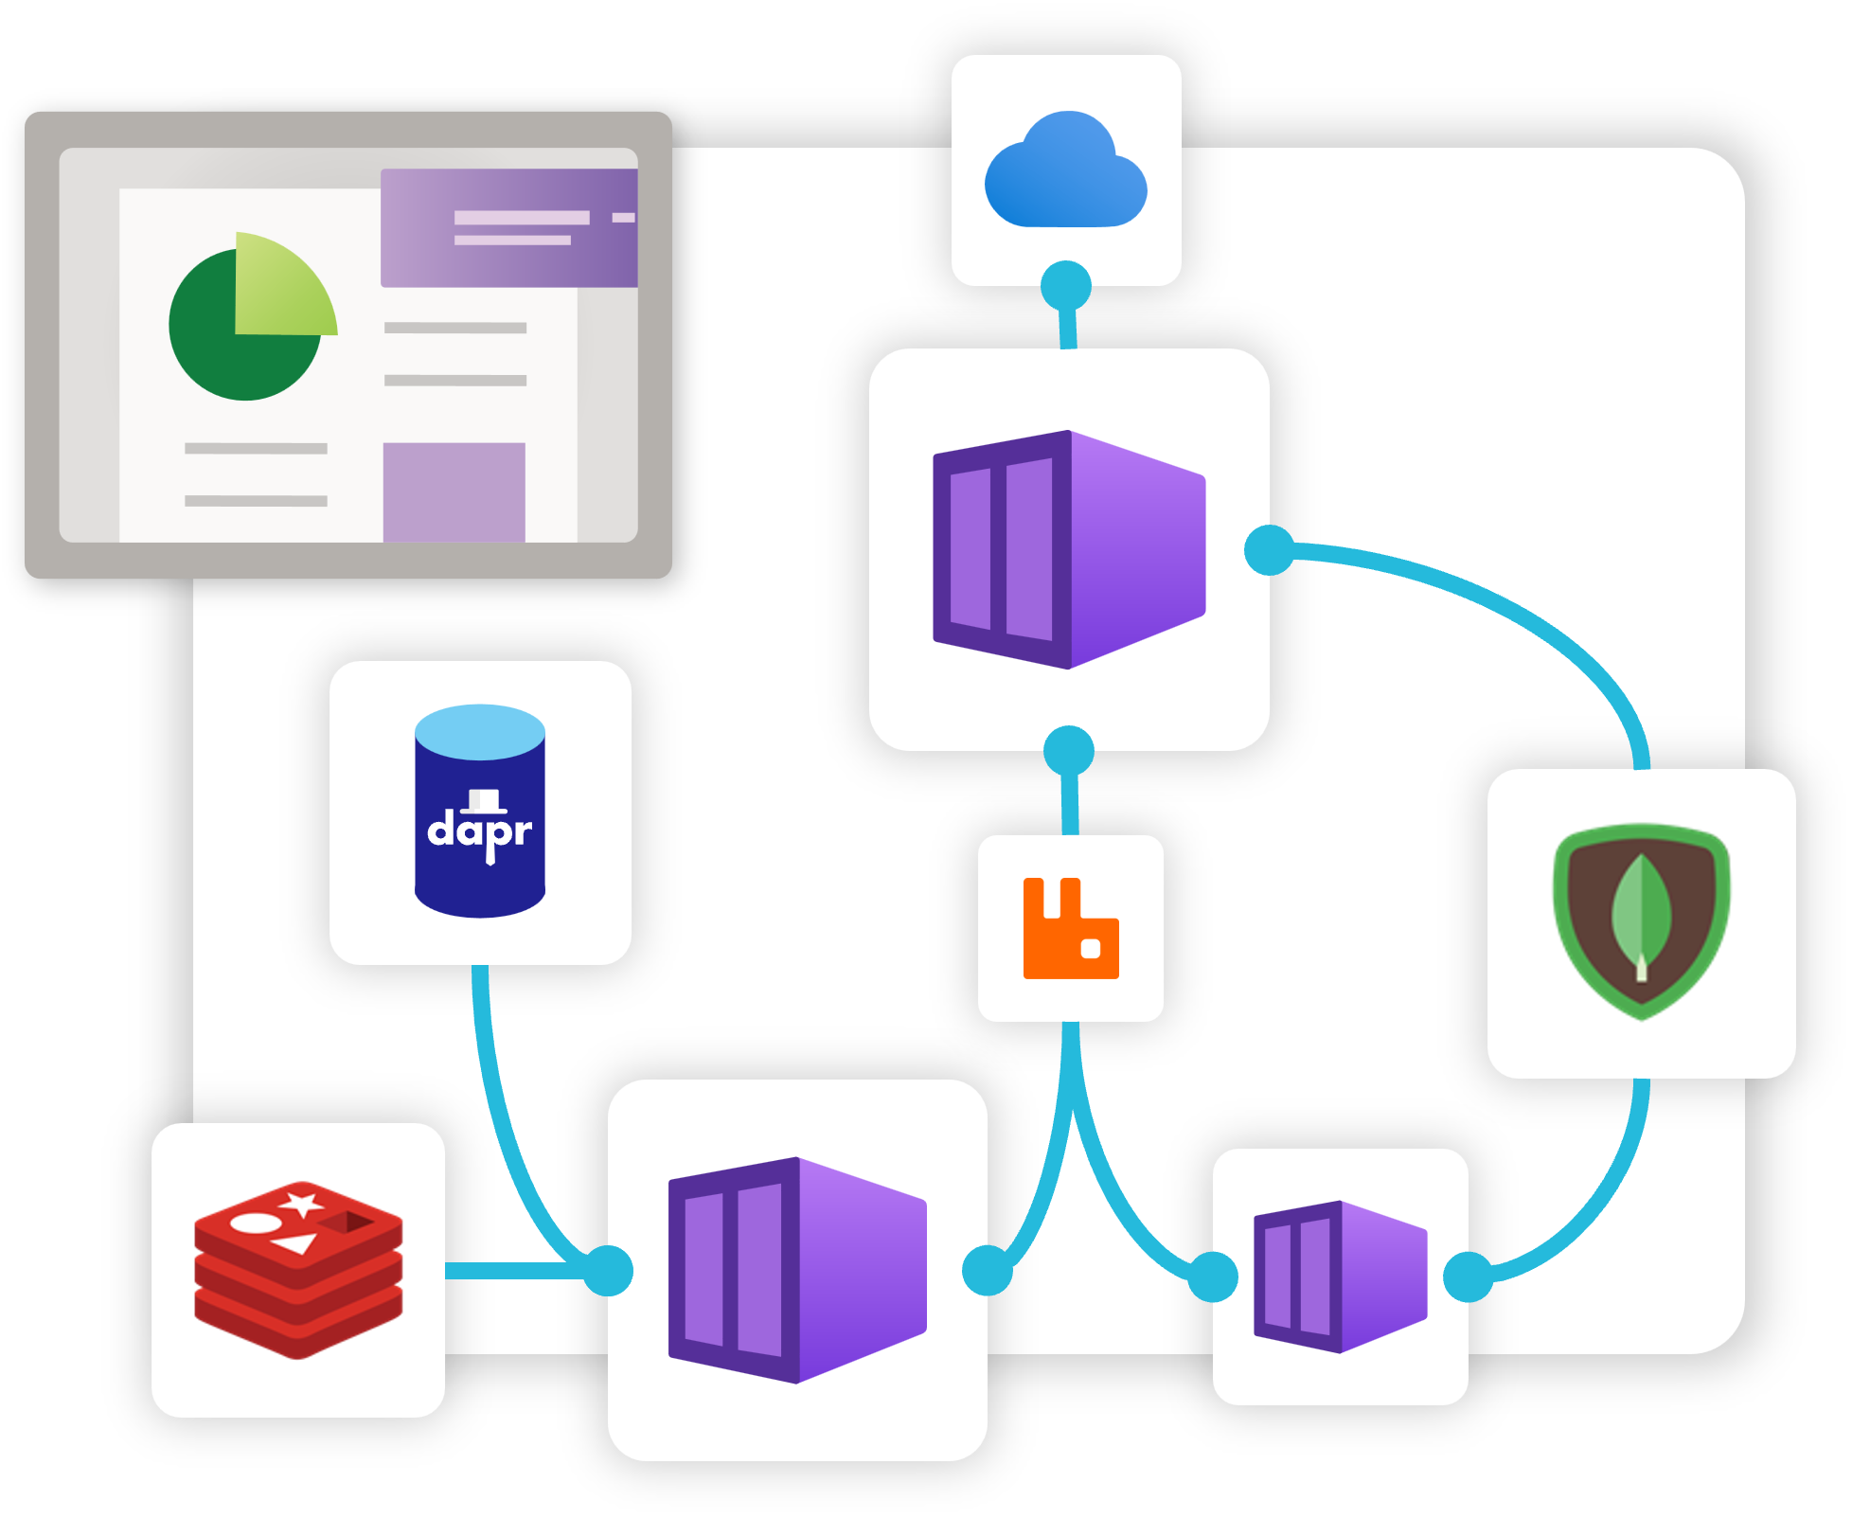
Applications
Primary resource that brings your application + infra together.
Includes services, dependencies, relationships.
Single description and view of entire app via an Application Graph
Notes:
Radius applications are the primary resource that brings all your services, dependencies and relationships together.
It gives you a single description of your application, allowing you to deploy and manage your application easily.
Radius applications capture this via an Application graph, which helps us deploy and understand our applications better.

Slide 10
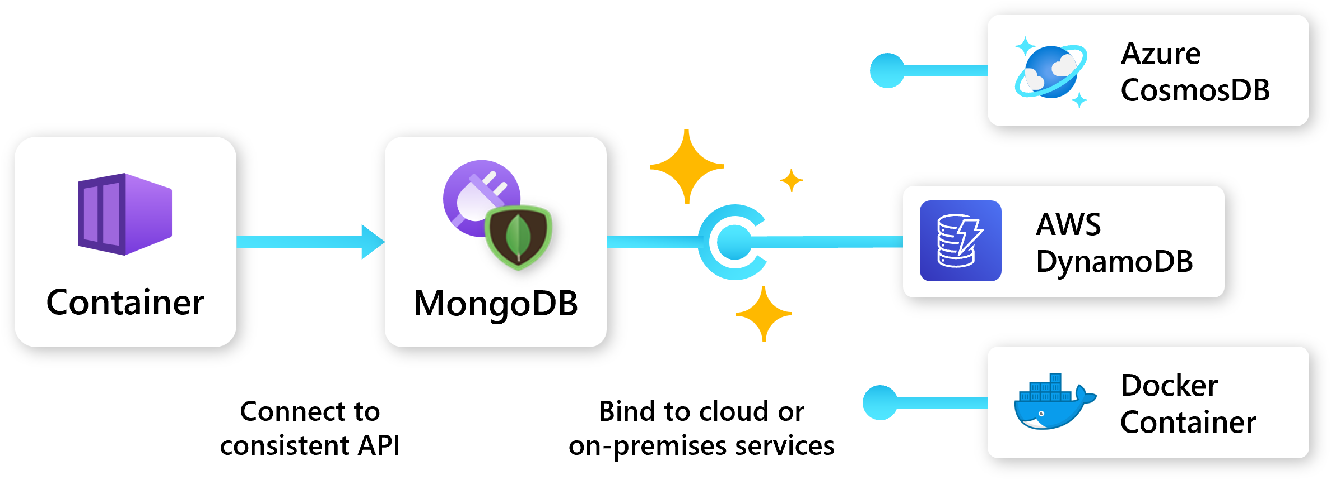
Application portability
Designed to be cloud + platform agnostic
Define app once, deploy to any platform that supports Radius.
Developers define app requirements.
Operators define environments and recipes that bind to those requirements.
Notes:
- Radius applications are designed to be cloud and platform agnostic.
- Once you define your application, you can deploy it to any cloud or platform that Radius supports. (Currently just Azure + AWS)
- This is great if we need to move our app between clouds, or between cloud and on-prem environments.
- Developers can define their requirements and dependencies, and operators can define their environments and Recipes that bind those requirements to the appropriate cloud resources.

Slide 11
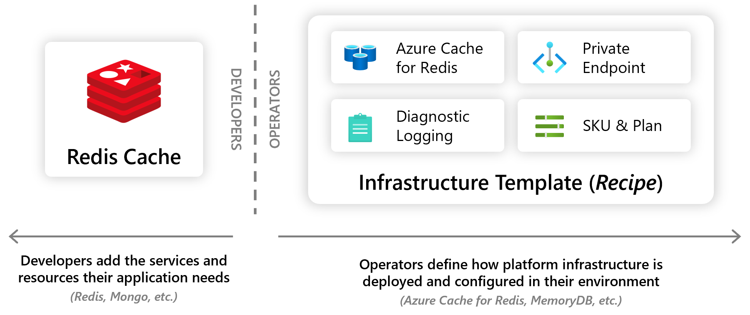
Radius Recipes
Recipes enable a seperation of concerns between Ops and developers by automating infra deployment.
Devs choose the resource they want.
Ops codify their environment with how these resources should be deployed.
Notes:
- Recipes enable a separation of concerns between IT operators and developers by automating infrastructure deployment.
- Developers select the resources they want in their apps, and Platform Engineers will codify in their environment how these resources should be deployed and configured.
- So when a developer deploys their application and its resources, Recipes automatically deploy the backing infrastructure and bind it to the developer’s resources.
- Currently, recipes support both Bicep and Terraform. You can use Recipes that Radius provides, or you can create your own custom recipes.

Slide 12
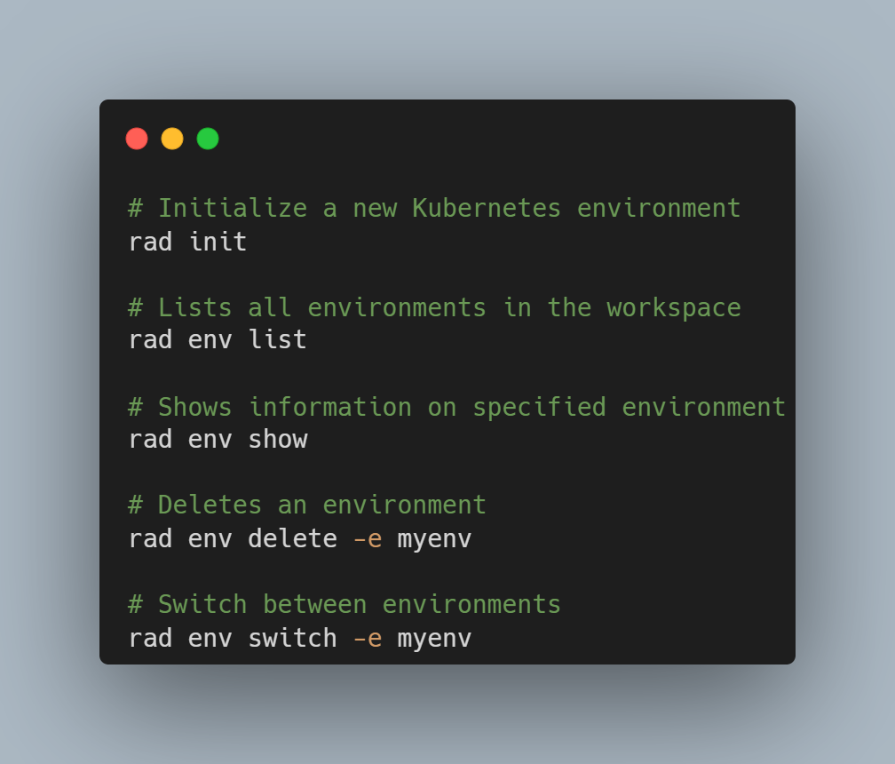
Environments
Prepared “Landing zones” for Radius apps.
Apps deployed to environments inherit container runtime, configuration, recipes, and other settings from the environment.
Environments are server-side resources that exist within the Radius Control Plane.
You can use the Radius API and rad CLI to work with environments.
Notes:
- Environments in Radius provide a landing-zone for apps that’s configured with the organizations chosen best-practices, settings, and Recipes.
- They encapsulate and store configuration for the compute platform, networking configuration, diagnostics, and other operational concerns.
- You can configure environments to vary across different types of deployments (like staging, production), deployment regions or even different clouds.
- Platform Engineers collaborate with app developers by managing the set of environments that developers can use
- When an app is deployed, Radius will bind the app to the configuration of the target environment, and apply the relevant settings.
- Operational configuration in the environment increases developer velocity because the app doesn’t need to change when it’s deployed across environments.

Slide 13
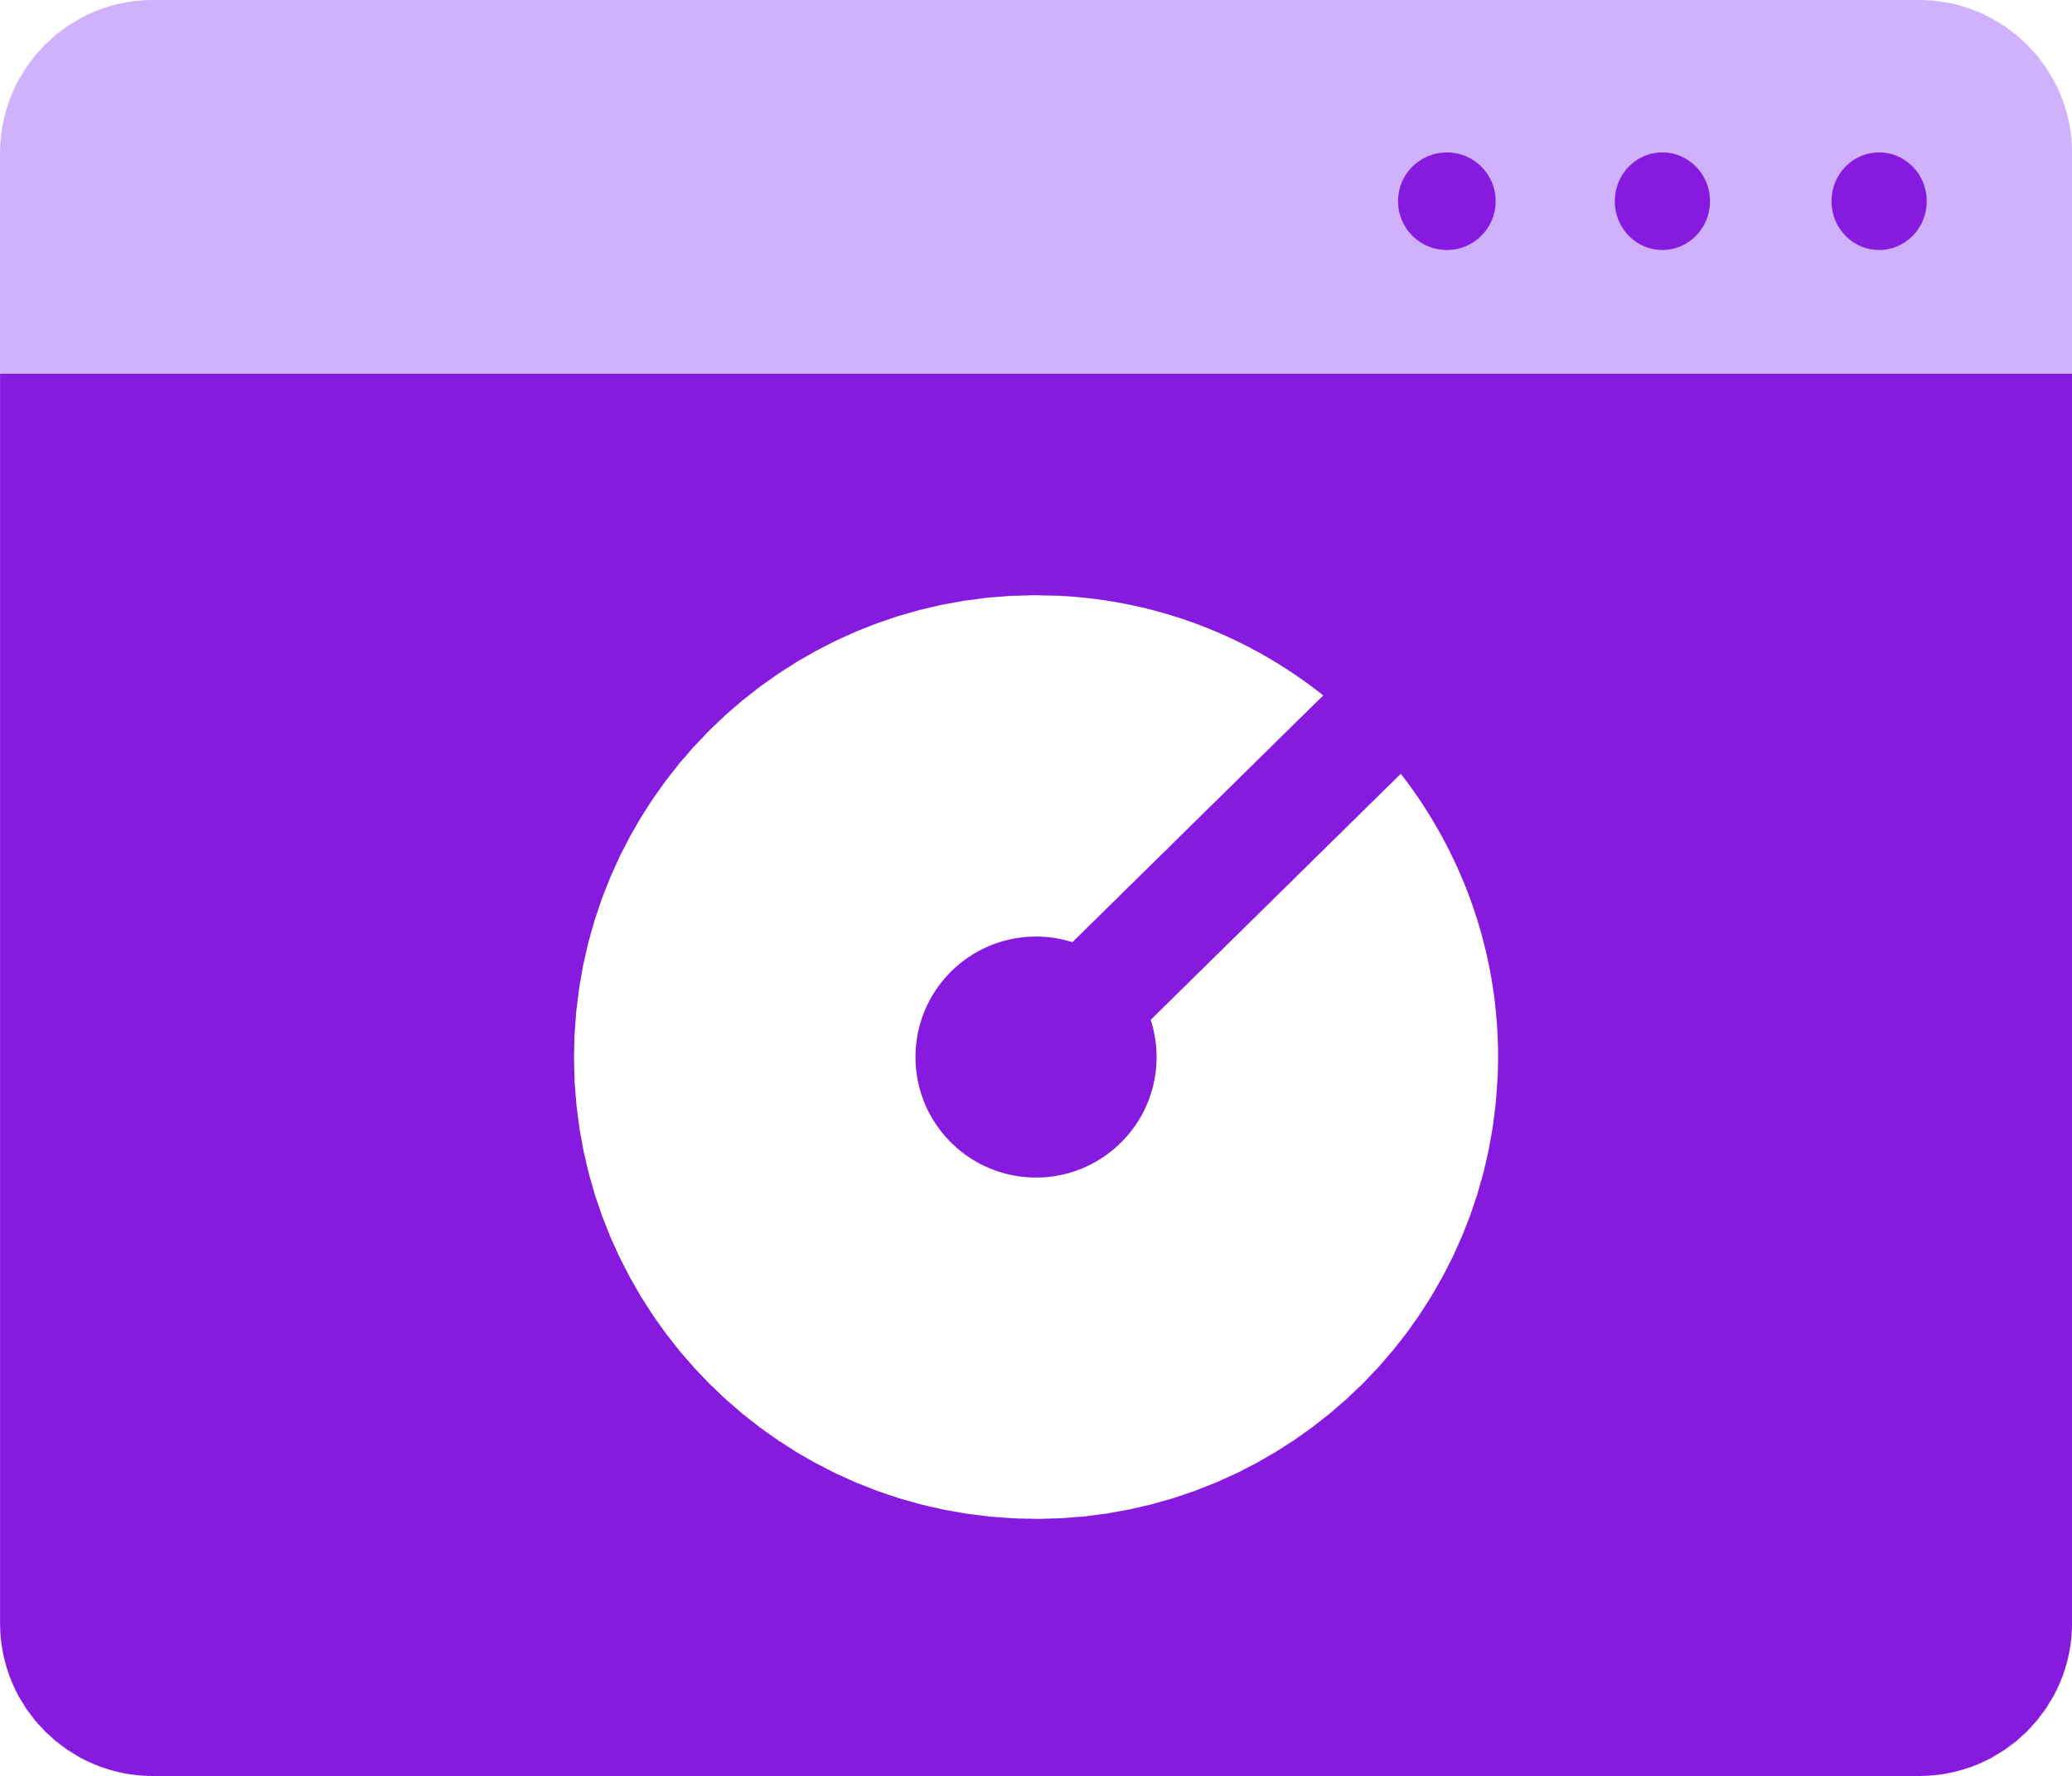
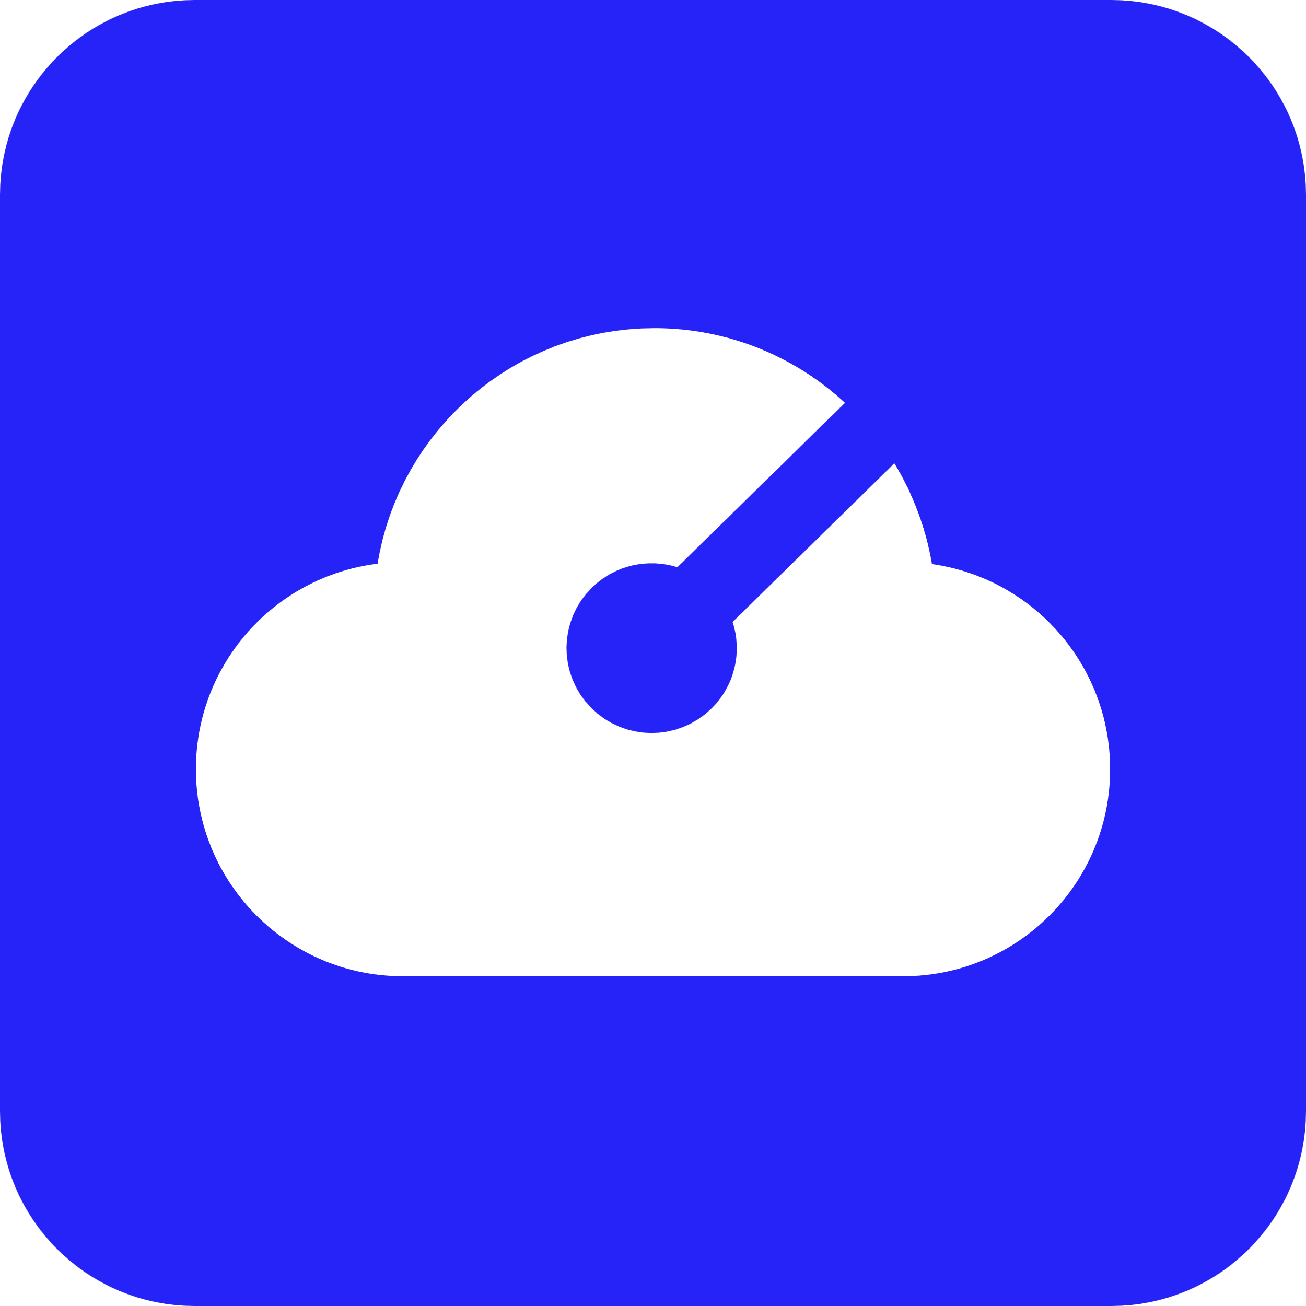




Application
Internet
Gateway
Frontend
Container
Backend
Container
Redis
Cache
SQL
Database

Slide 14

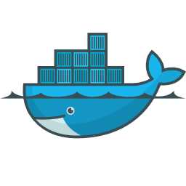
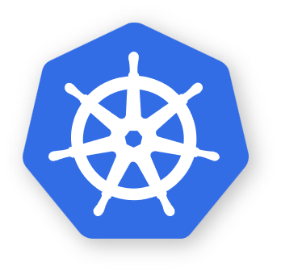


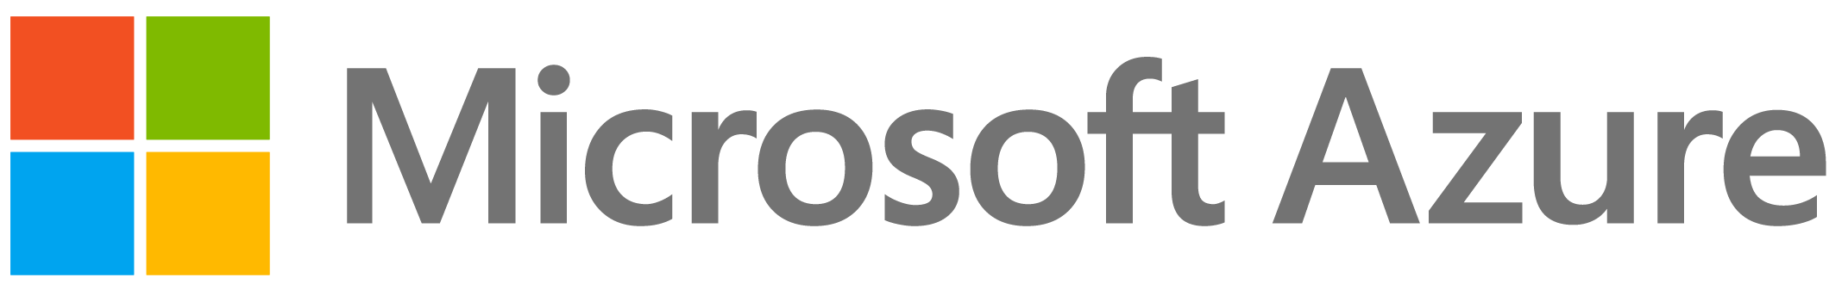
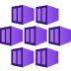

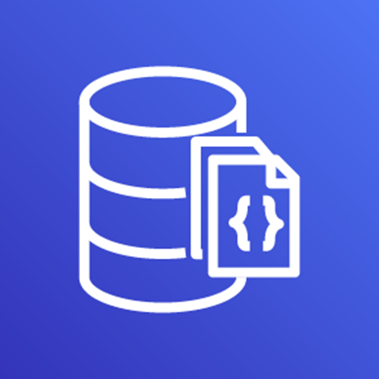
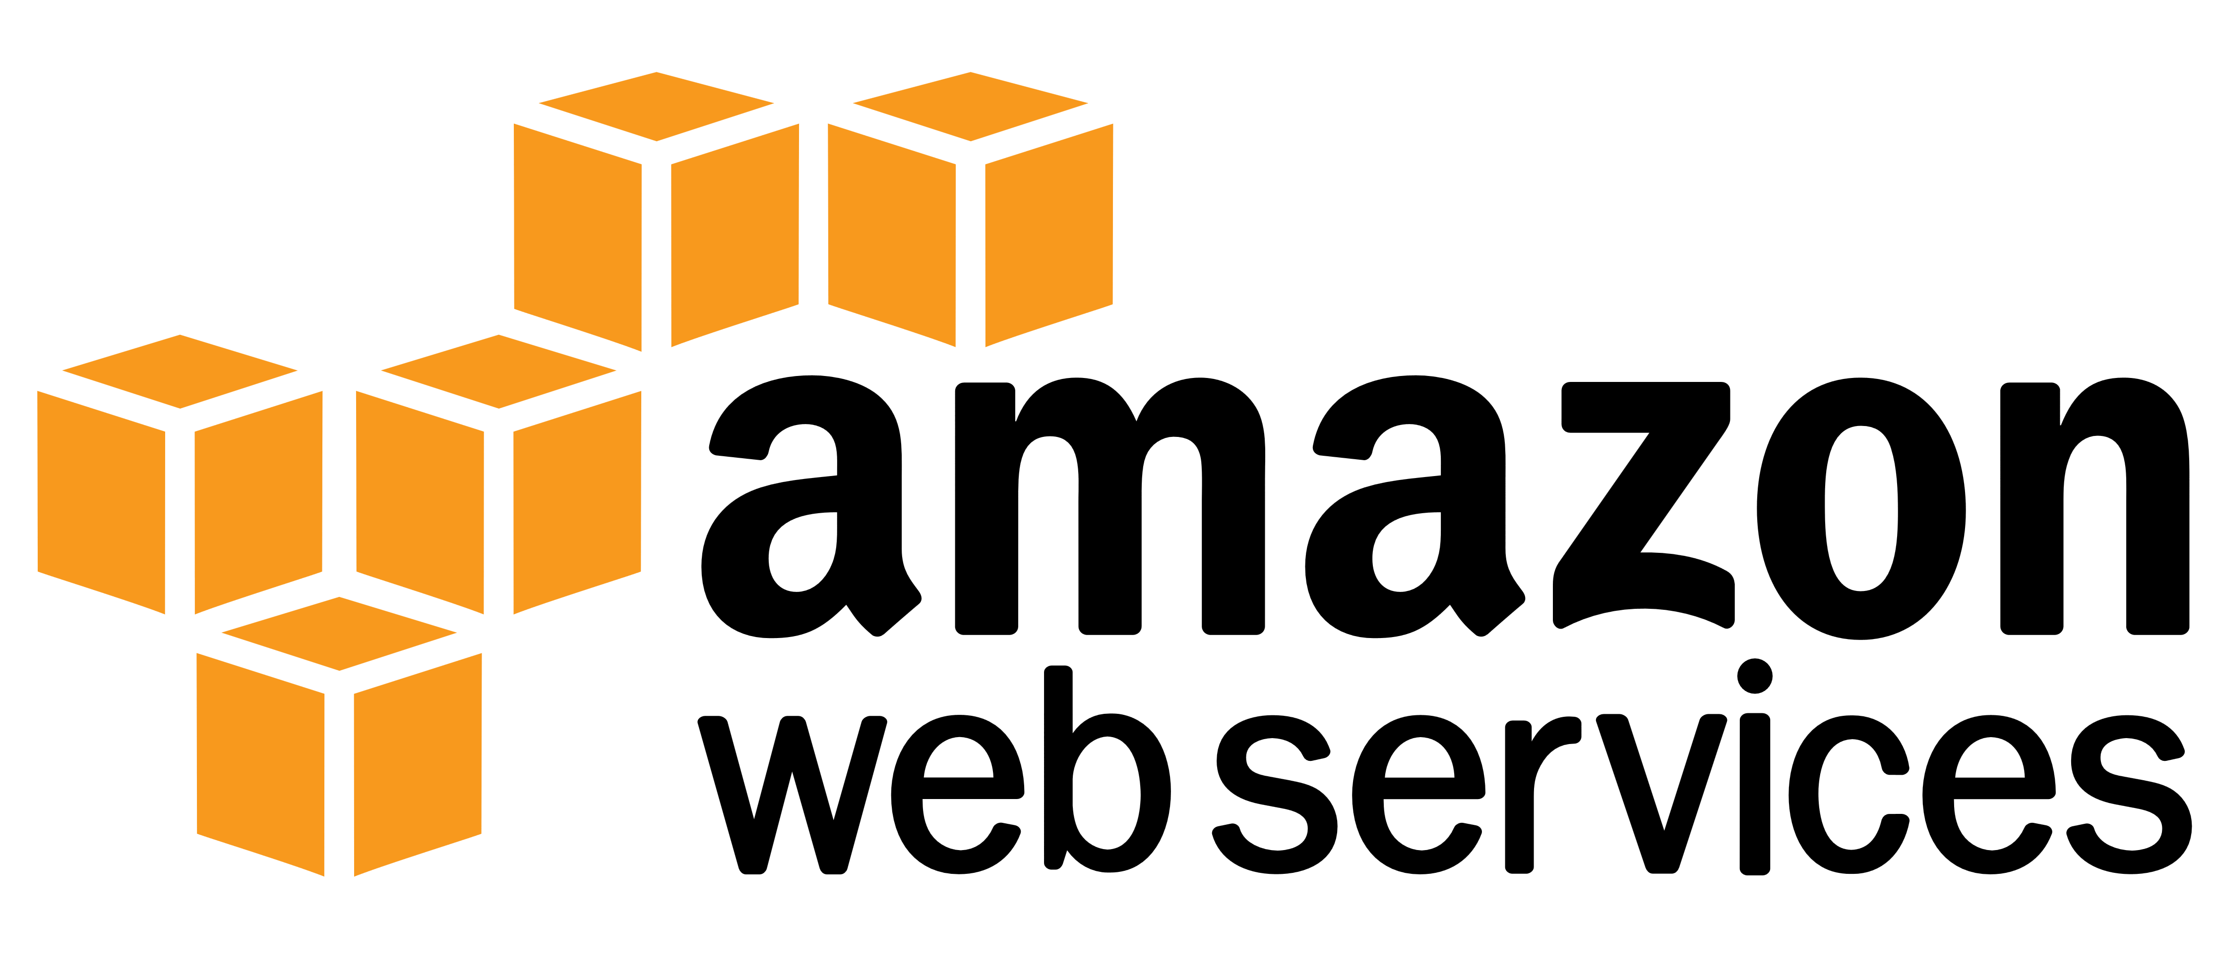

Environment
RECIPES
Redis
Container
SQL
Container
Local development
COMPUTE
CNCF-certified
Kubernetes
Application
Environment
Internet
Gateway
RECIPES
Azure Cache
for Redis
Azure
SQL DB
Frontend
Container
RECIPES
Backend
Container
Redis
Cache
COMPUTE
Azure
Kubernetes Service
SQL
Database
Environment
RECIPES
AWS
MemoryDB
AWS
DocumentDB
COMPUTE
Elastic
Kubernetes Service

Slide 15
Let’s build some Radius Apps!

Slide 16
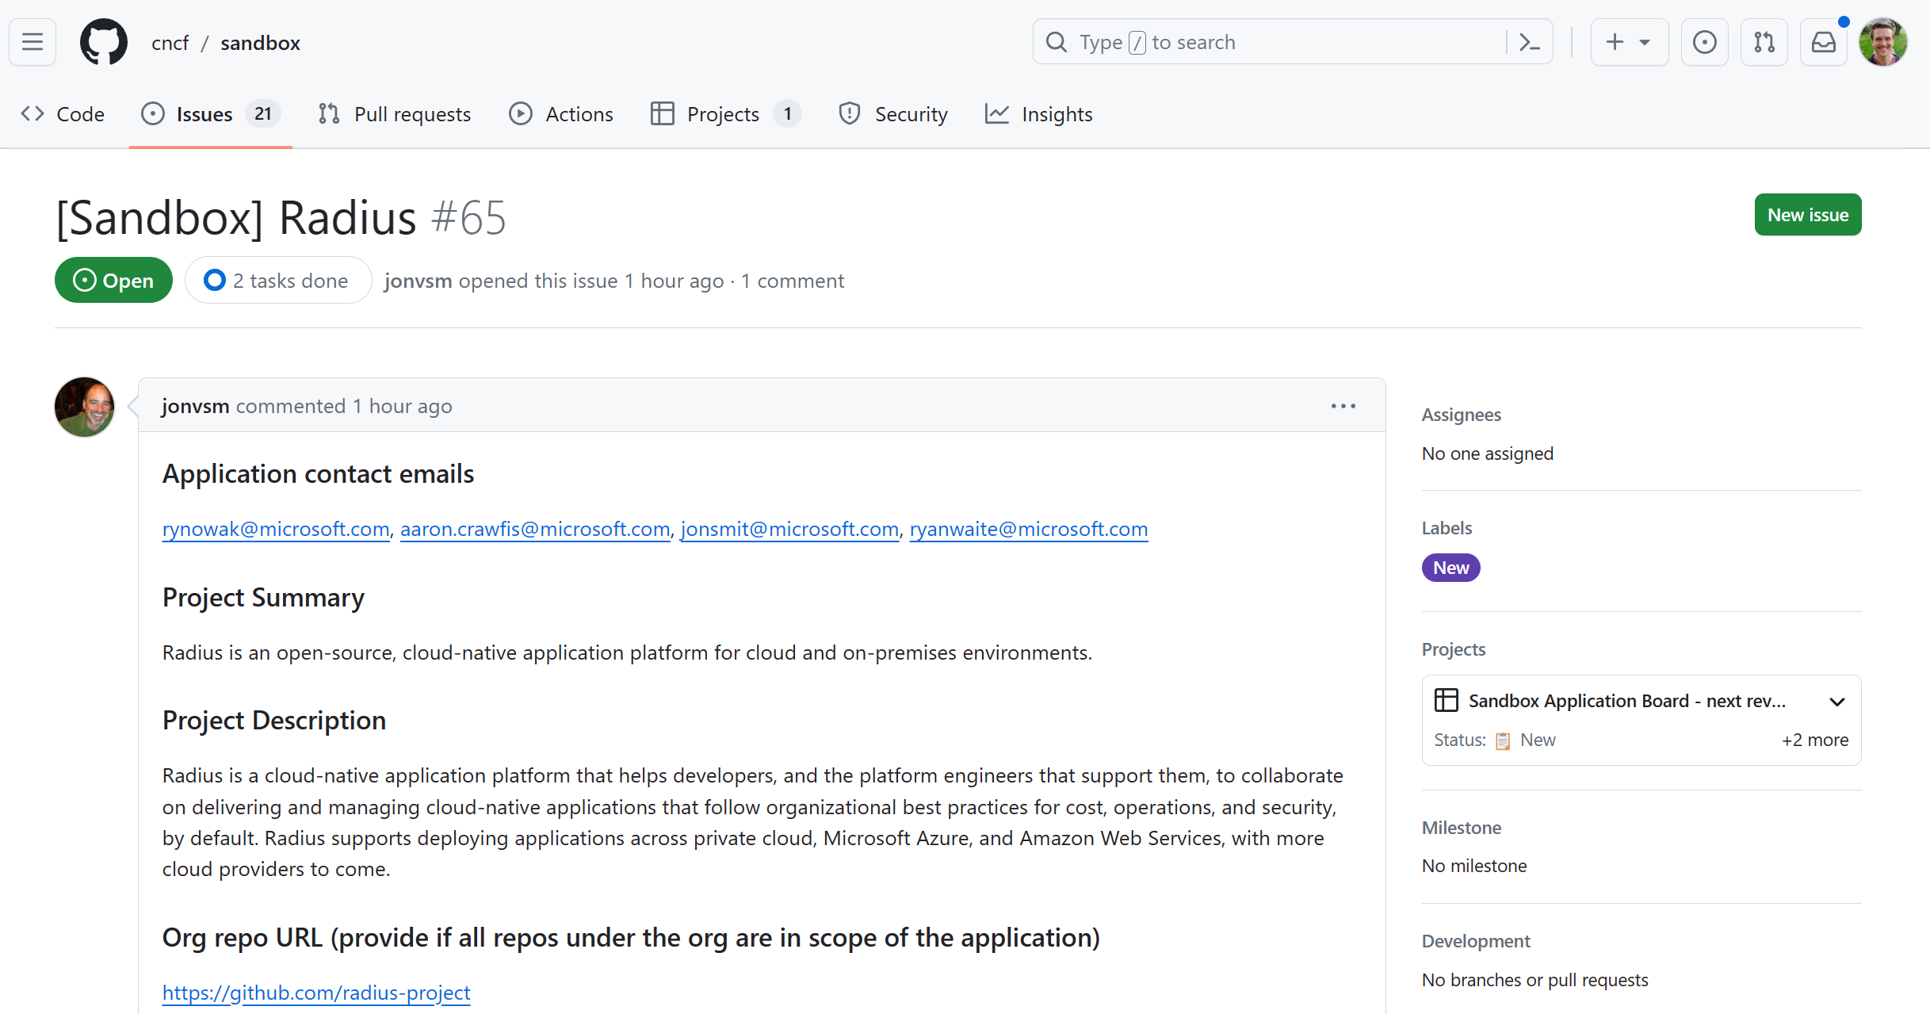
Submitted to CNCF
aka.ms/radius-cncf

Slide 17



radapp.io
aka.ms/radius/discord
github.com/radius-project

Slide 18



Thanks for listening!
willvelida.com
github.com/willvelida
twitter.com/willvelida
linkedin.com/in/willvelida
youtube.com/@willvelida

